Slide 1


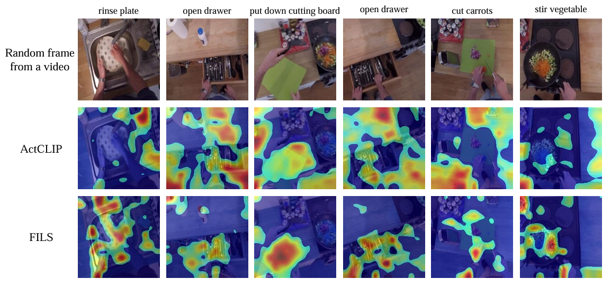
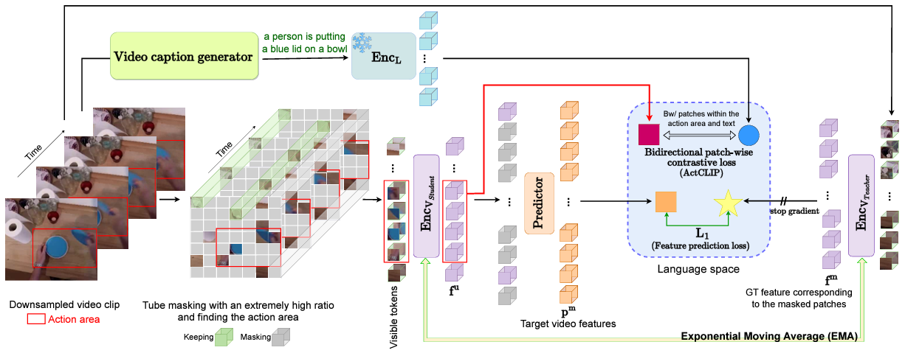
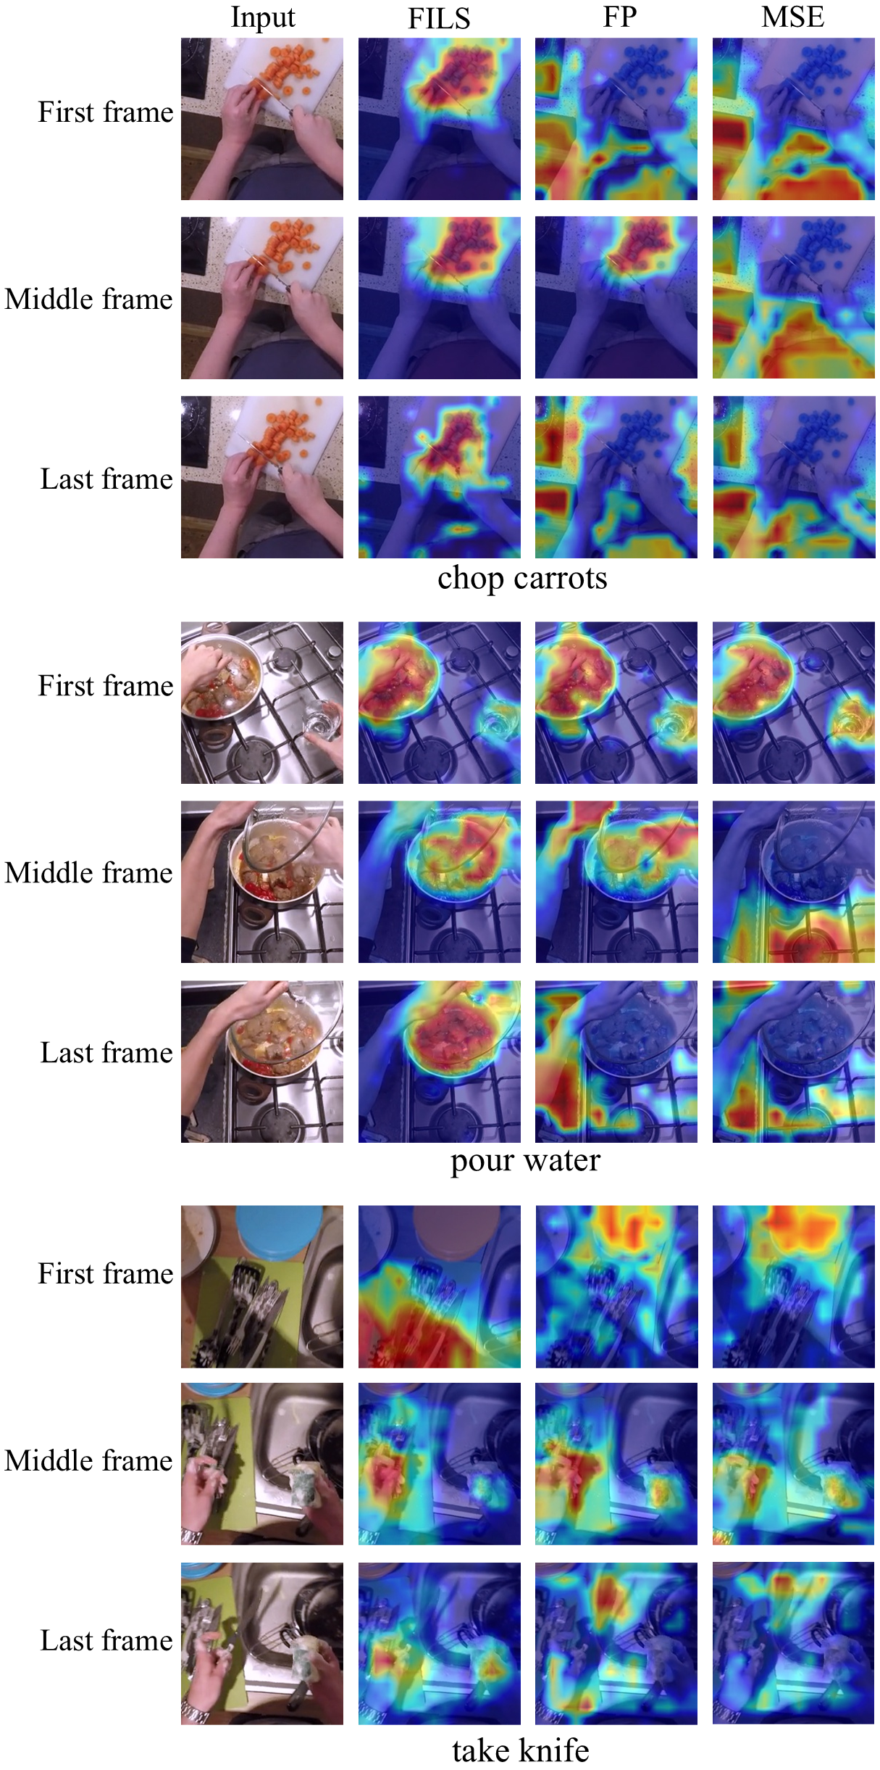
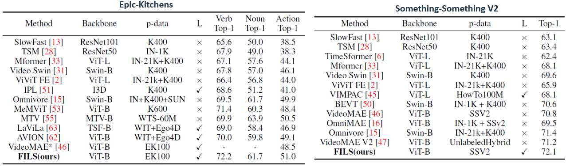
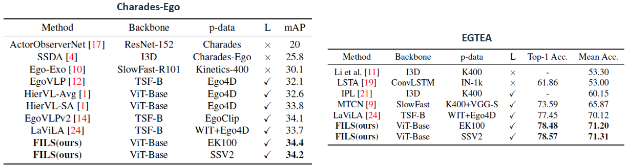
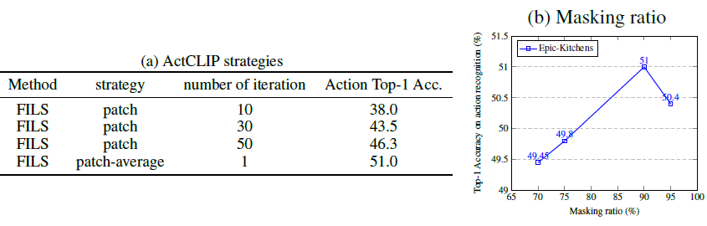
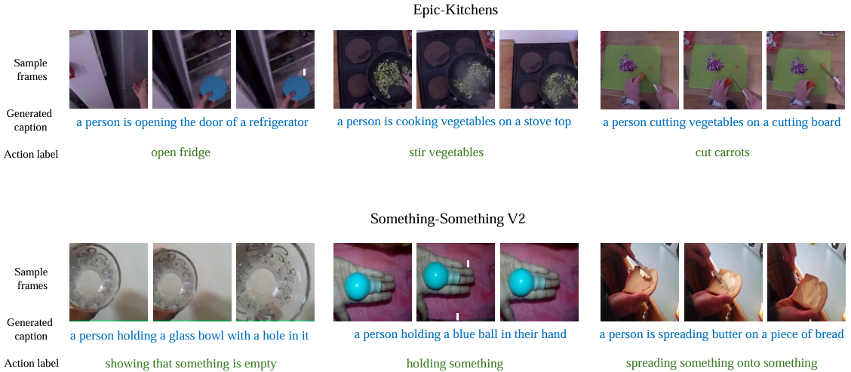
FILS: Self-Supervised Video Feature
Prediction In Semantic Language Space
m.ahmadian@surrey.ac.uk Code: github.com/Moohnai
Mona Ahmadian Frank Guerin Andrew Gilbert
Contributions
Motivation behind FILS is to bridge vision and language, leveraging text descriptions to guide video representation, enabling a more semantic comprehension of action and context in video data.
• Feature prediction strategy on masked video and patch-wise contrastive learning within potential action
• ActCLIP is a technique used within FILS that applies CLIP-based contrastive learning specifically to patches in video action areas, aligning motion regions with their corresponding text descriptions
• Demonstrating the effectiveness of using mutual information to prioritize patches that convey semantic
and action-rich details, enhancing learned representations for various tasks
Visualization of the similarity between text (action label) and video features
Method
Qualitative Results
Results
FILS represents the potential semantic region in the video and acquires an understanding of spatiotemporal relationships
Superior performance across all metrics on the action recognition datasets
Ablation Studies
Synthetic captions
Epic-Kitchens
Something-Something V2

